Slide 1
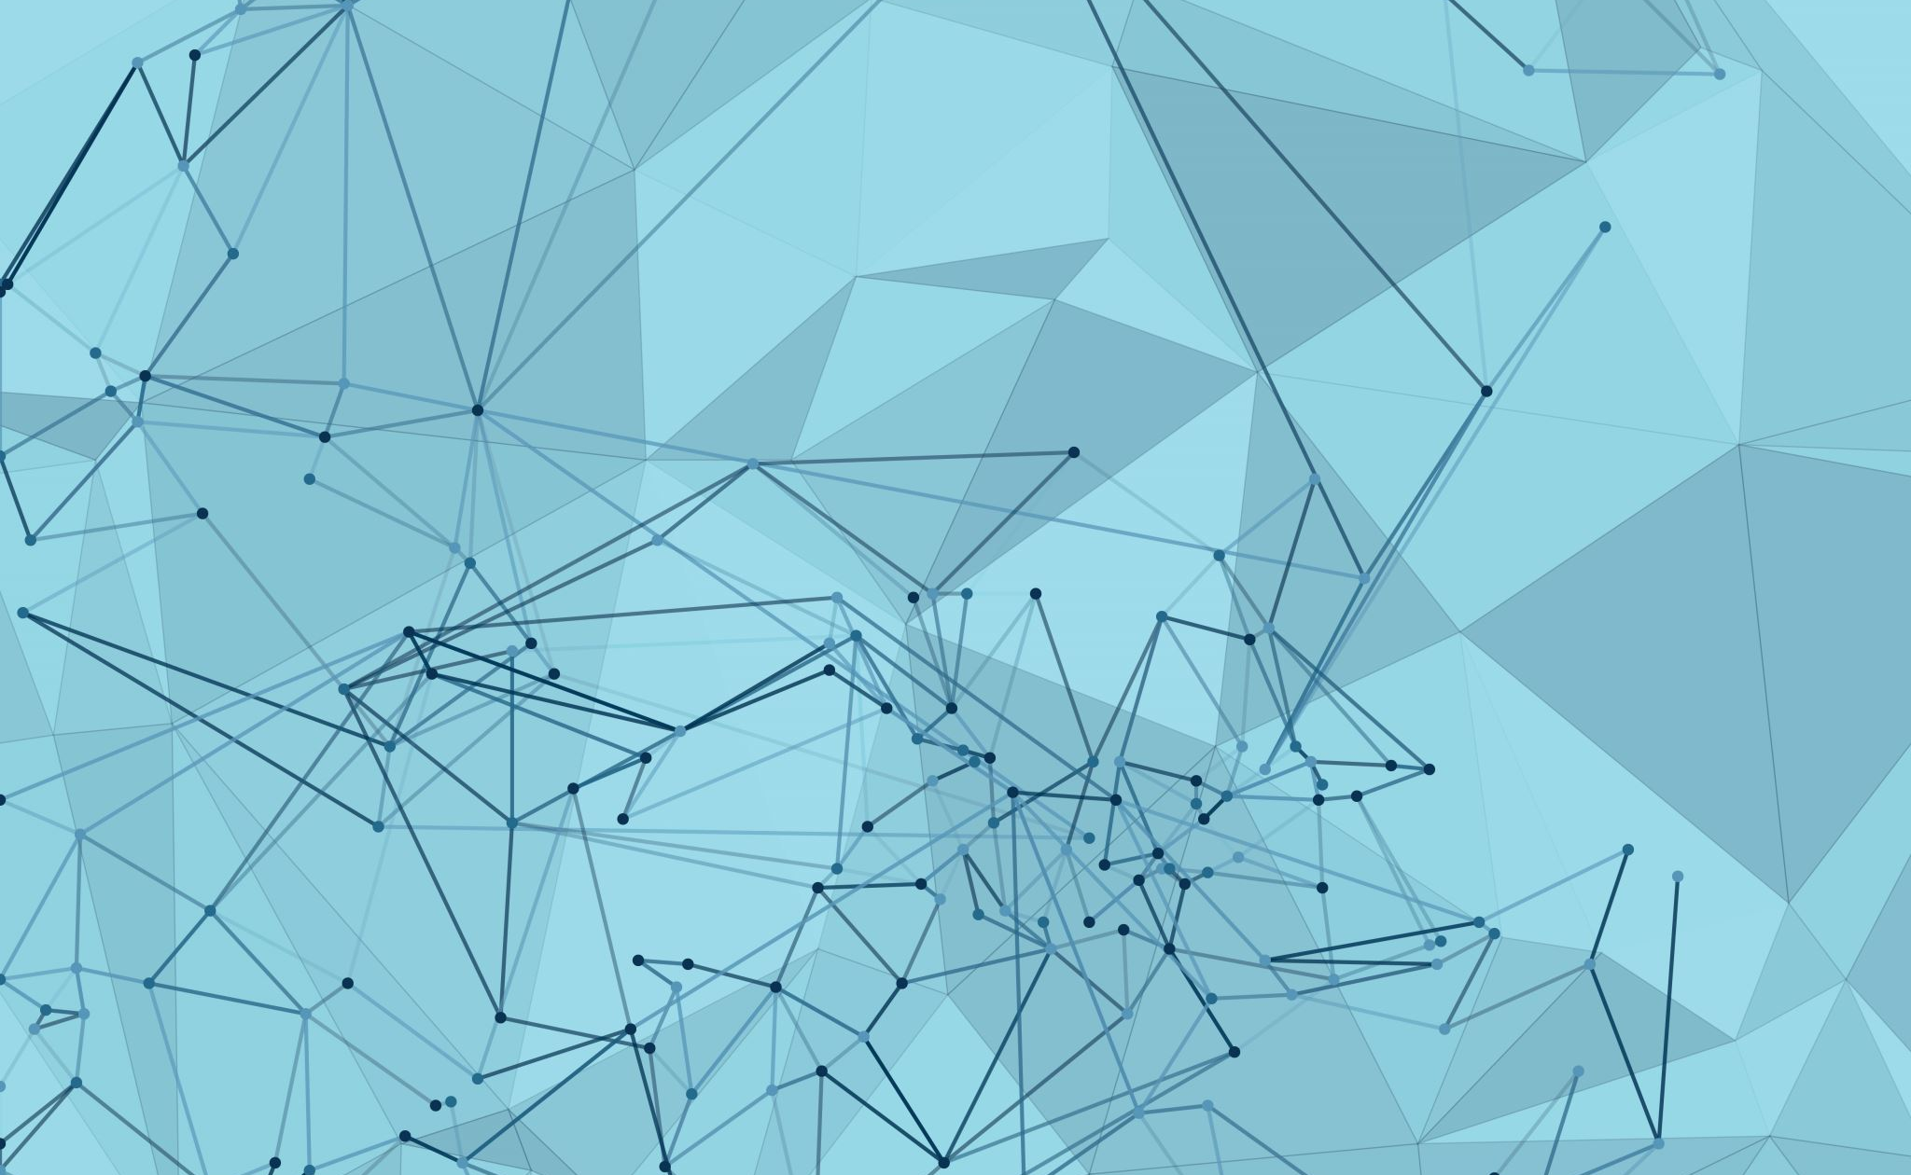
DeepExtract by AI
TEAM PHOENIX

Slide 2

Problem Statement
Most of the GEN AI cases across the bank need to process the documents in pdf/image format through OCR or other paid tools . An in-house Gen-AI powered solution is essential to streamline the process of data extraction, summarization and validation .

Slide 3


Design Details
AI Agent- Read
Uploaded file
and summarize
Web Interface- Upload file
Web Interface- Summarized
content
User

Slide 4








Tech Stack

Slide 5
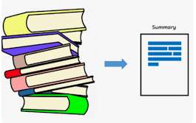
Extraction and Summarization
Apache Tika
Extracts content from provided file
AI Agent
Gemini summarizes content of files
Cloud SQL DB
Data Persistence

Slide 6


Slide 7
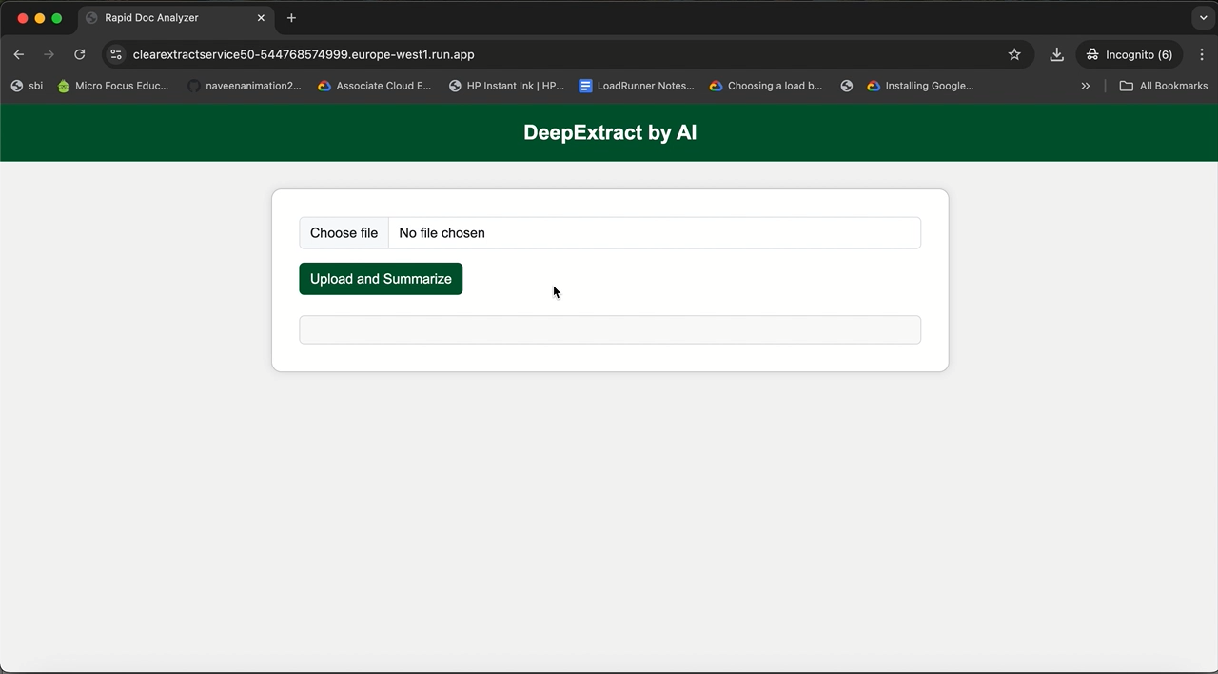
Demo

Slide 8

What’s Next?
Build In House LLM Model
Add Accuracy functionality to improve summarization of content
Support large documents
Improve web interface to better user experience

Slide 9


Slide 10


